Slide 1
Borrowing money from a friend can harm or damage the friendship.
TOPIC
Group: 6
Members: Senrin Sim
Khav Saroeun
Samorn Mai
Notes:
Hello, theacher and hello everyone . I’m from group 6, my team member are (senrin sim, mai samorn, and khav saruen) This morning we going to show you all about one TOPIC that talk about BORROWING MONEY FROM YOUR CAN HARM OR DAMAGE THE FRIENDSHIP. Hrr ohh what is the meaning of this topic? So to make it clea and make sour for you all get understand the topic les’go to the presentation all together. Les’go!

Slide 2
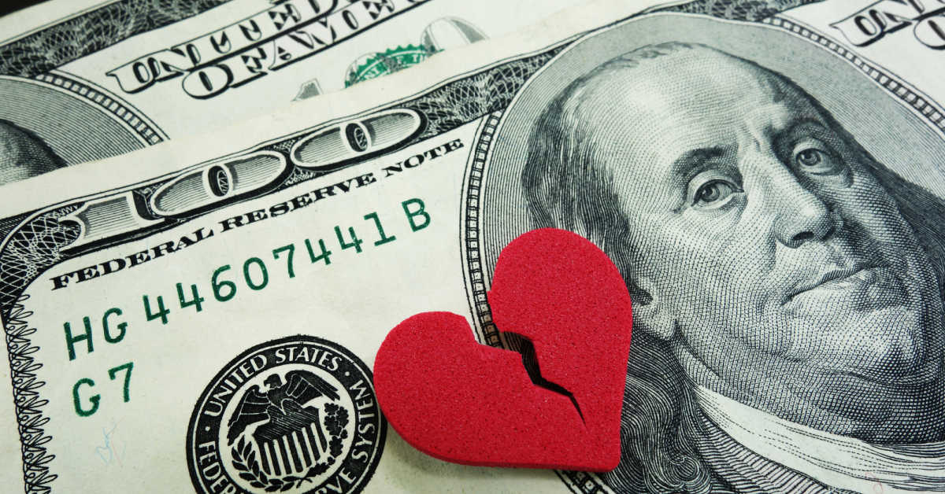
Relationship is broken only a reason is BORROW money.
Notes:
Nowaday, in our modern world, some kind of relationship was broken only a reason for borrowing money.
It is my personal opinion if you borrowing money from your friend and never return it back,
so in that cas it harm your friendship.
But if you return it on the time it can not harm your friendship.

Slide 3

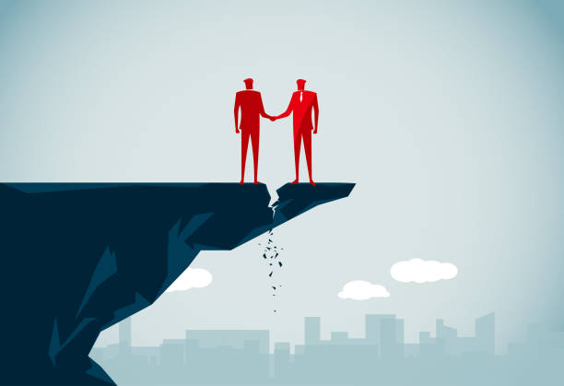
It was harm of your friendship if you don't pay the money back to your freind.
We are best freind
We are not freind

Slide 4
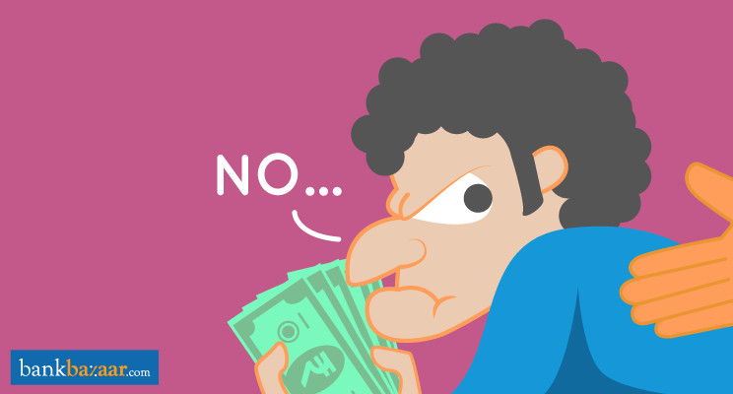
If you borrow money from your friend and you never return back to your friend.
You will make a relationship to be broken.
Your friend don’t trust on you.
Notes:
If you borrow money from your friend and you never return back to your friend it mean you are a bad person already in your friend mind. Because what?
He will think about you that you are a untrust person in his mind, Because you have had cheating your friend by you not pay money back to your friend. And you proboly made your friendship to be broken also. In the this point I mean you will make a relationship to be beoken and make your friend don’t trust on you when you want your friend’s help in the next time. Why I say like that? Go to the next slide I going to show you about a reason that you make your relationship was broken cause only borrowing money.

Slide 5
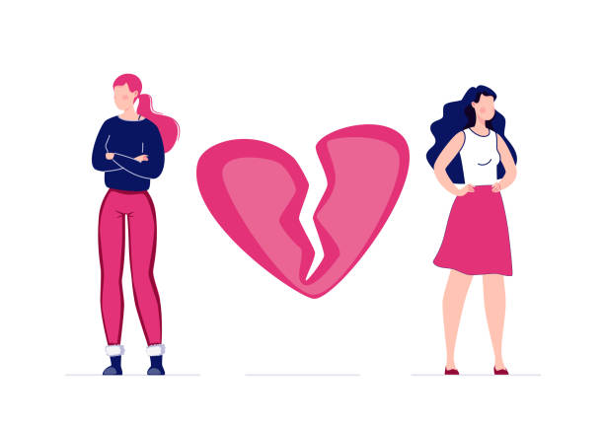
Relationship is broken.
When you never pay back the money to your friend.
Notes:
In this dark side, if you borrowing money from a person and never return, it would harm your friendship. For example, someday ago my friend borrowed money from me. I was not sure about him, but he requested to me to he needs money for some inportant reason. So I believed and gave money. After that when I call hem, he never picked up my phone or never replied to my messages. In that case he aboided me and never contacted me to return my money. So tin that time it had harming our friendship. And make me don’t trust him also. Why I don’t trust ? Go to the next slide my friend will show you.

Slide 6
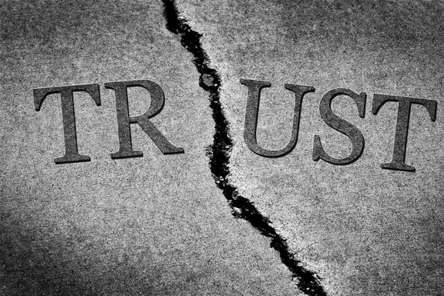
Your friend don’t trust on you.

Slide 7

CONCLUSION
To sum up, when you borrow the money and you always returning at that time, it will help to keep your friendship stronger and never cut the relationship.

Slide 8
THANK YOU!

